Slide 1


Gen AI Engineering
Python Base Camp 1 : Session 1
Set up your PC and Environment & . Python Basics - Hands on

Slide 2


In this session …
Install python in your PC
Install VSCode IDE and basic extensions
Write and execute basic python programs
Learn about virtual environment
Learn about Function, Module, Package
Learn basic file handling
Set up your accounts in Google Colab, Git Hub, Groq

Slide 3

Python Installation
Download the Python installer from https://www.python.org/downloads/
Choose a stable version in 3.12 or 3.13
Choose installer for your Machine type (Windows / MacOs)
Complete the installation
Check the installation
Command Prompt : python --version to see the version installed
Command Prompt : where python to check the path installed
Run basic python code lines
Open python console (windows → python)
Try : print (“My first python code”)
Try :
X = 55
Y = 10
X + Y
Run a program
Download My_First_Prog.py
Command Prompt : python My_First_Prog.py

Slide 4
VSCode Installation
To develop, execute and debug python code, we would require an IDE
MS Visual Studio Code is a versatile IDE, that supports many languages and is feature rich
Installation of VSCode
Download the VSCode installer from https://code.visualstudio.com/download for your machine.
Complete the installation
Open VSCode editor and open the file My_First_Prog.py
Ctrl + Shift + P → Python : select interpreter → Choose the python installed in your PC
Execute the program
Install extensions : Go to extensions tab and install the following
Python
Python Debugger
Jupyter
Docker
Data Wrangler

Slide 5
Working with Python Note book (Jupyter)
Jupyter notebook is an interface that helps to develop code (various languages) in a ‘prototyping’ mode.
Its organised as ‘cell’ and can be executed cell wise (not entire program)
This gives a great advantage when you develop software
Jupyter extension in VSCode allows to create and use Jupyter notebooks.
Open a note book and execute the code
Open 2_First_Note_Book.ipynb in VSCode
Execute each cell. Add more cell, modify and try your hands.
Open the ‘Jupyter’ tab and check the variables stored.
More to understand Jupyter note book
Open 3_More_about_Jupyter.ipynb in VSCode
Check the documentation cells (Try to edit them)
Execute the code and check the output file
Indentation of blocks in python
Observe Variable scope and persistence.
Modify one of the block and execute
Now that we have understood note book, let us learn some basic of python, using 4_Python_Basics.ipynb

Slide 6
Virtual Environment (vEnV)
Python being a versatile and powerful scripting language, it is popular and well accepted because of …
Continuous enhancement and evolution of the interpreter itself
Big collection of special purpose packages / libraries maintained as open source
Community Resources
At the same time, this flexibility and constant evolving nature can bring challenges in …
Having a clear baseline in terms of interfaces among libraries
Clarity in terms of environment (version of py, version of packages etc)
Having a environment agnostic development
Dependency management
One of the concept used to overcome these challenges is Virtual Environment. This allows your python code in an environment, that is clearly defined and ‘frozen’.
In a vEnv, python version is maintained at specific one.
Packages which are installed are maintained at a specific version
You can create and replicate the environment required for your python program / app

Slide 7
Virtual Environment (vEnV) contd …
Creating a VEnv
Command Prompt : where python
Command Prompt : python -m venv <Your_vEnV_Path>
Command Prompt : <Your_vEnV_Path>\Scripts\activate
Command Prompt : where python
Inspect the directory structure
Installing Packages via pip
Go to your virtual environment and activate
Command Prompt : pip install numpy
Inspect the directory structure @ <Your_Env>\Lib\site-packages
Command Prompt : pip freeze
Command Prompt : where python
Inspect the directory structure
Installing Packages using baseline reference
Go to your virtual environment and activate. Copy the file requirements.txt
Command Prompt : pip install -r .\requirements.txt
Inspect the directory structure @ <Your_Env>\Lib\site-packages
Command Prompt : pip freeze

Slide 8
Function, Module, Package
Python supports modular way of programming, which is the basis for maintainable & scalable code base.
There are basic constructs that are used in achieving the modularity
Function : It is a block of code, that is re-usable, callable and functionally distinct
Module: Module represents a *.py file, which contains multiple functions, variables & other executable lines of code
A module or part of a module can be used in another python code via ‘import’
Package : It is a collection of multiple modules. Typically organised in folder and having a init file
Class : Python supports Object Oriented Design. Class is the basic notion in OOD
Let’s explore these constructs through 5_Functions.ipynb, Data_Processing.py and Use_Module.py

Slide 9
File handling
Python natively provides file handling functions (open, close, read, write)
These functions can handle files in various modes: Read, Write, Append, Binary etc
Read : File is opened in read only mode
Write : File is opened and handled in write mode
Binary : By default it is considered as text file. But Binary mode allows to handle binary files.
A specific library ‘csv’ can be used to handle csv file. This provides more practical way to handle csv file than handling through normal file handler
Can be read row wise the contents
Can write row(s) from data structure
We explore file handling examples through 6_Files.ipynb
Read : File is opened in read only mode
Write : File is opened and handled in write mode
Binary : By default it is considered as text file. But Binary mode allows to handle binary files.

Slide 10
Google Colab, GitHub, Groq
Google Colab is a cloud environment (sandbox kind) where you can write and execute python scripts. https://colab.research.google.com/
Its available as note books. The *.ipynb files can be used as well.
Linked to your google account. Activate and try to create simple python note books
Be mindful of limitations (temporary sessions, limited number of parallel sessions, no possibility of python files)
Git hub is an environment where you can have repositories to preserve and maintain your artefacts (code, documents etc). https://github.com/
You can do version control on files
You can have Public / Private repositories.
Can be helpful to collaborate
Groq is a cloud platform that provides basic LLM APIs. These LLM can be invoked from your python scripts. https://console.groq.com/playground
Create your account and get an API key (Free Tier available with limitations)
Explore LLM from your python script using 7_Groq.ipynb

Slide 11
For Further reading / exploring …
To learn more in detail about the topics, you may refer the following content.
VSCode : https://code.visualstudio.com/docs/getstarted/getting-started
vEnv : https://docs.python.org/3/library/venv.html
Modular Design : https://python-course.eu/python-tutorial/modules-and-modular-programming.php
Pip : https://pip.pypa.io/en/stable/getting-started/
Object Oriented Design : https://realpython.com/python3-object-oriented-programming/

Slide 12
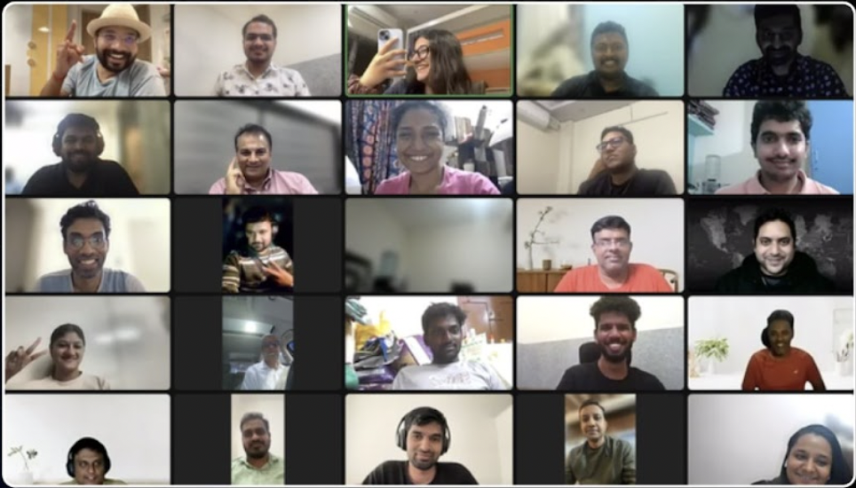


Time for Q&A :)

